Slide 1
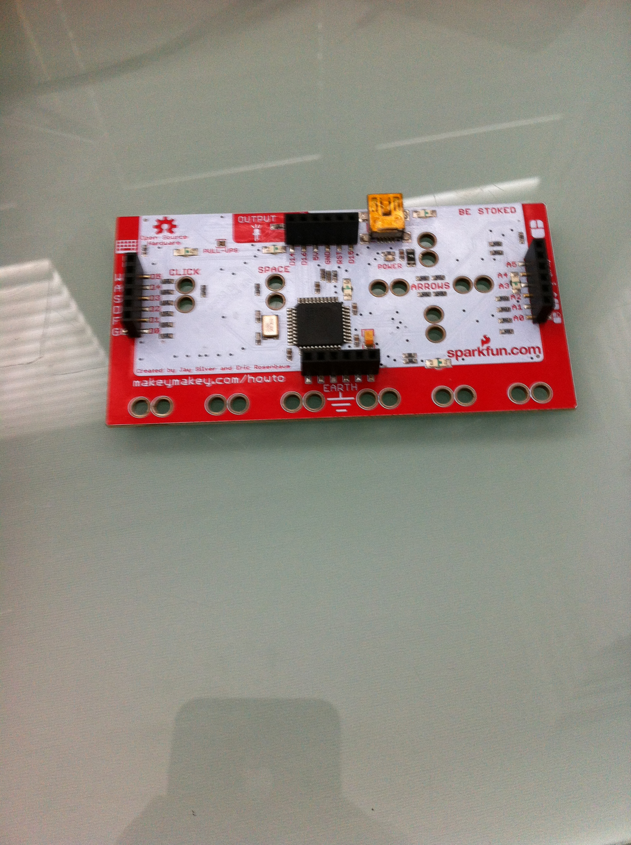
OLM Year 1 Coding Using the Makey Makey Board

Slide 2
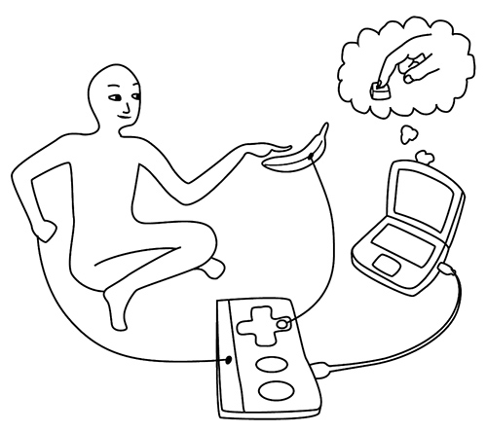
How does the Makey Makey Work?

Slide 3
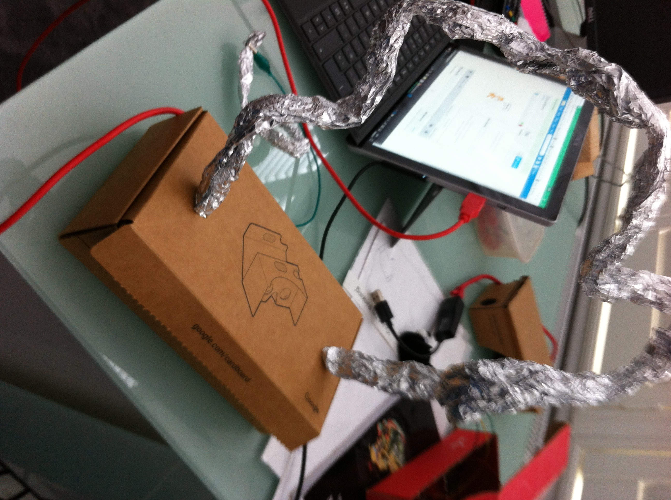
Make a “Don’t touch the wire!” Game

Slide 4
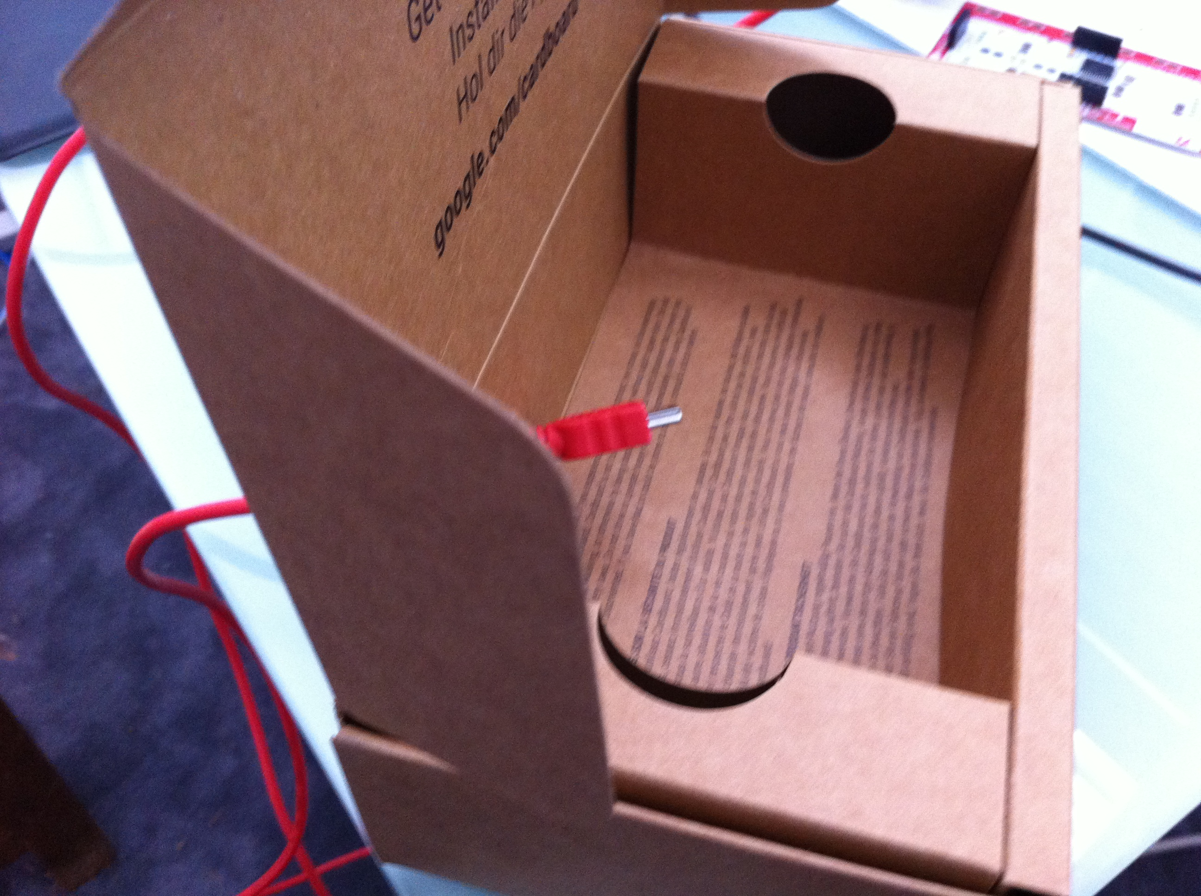
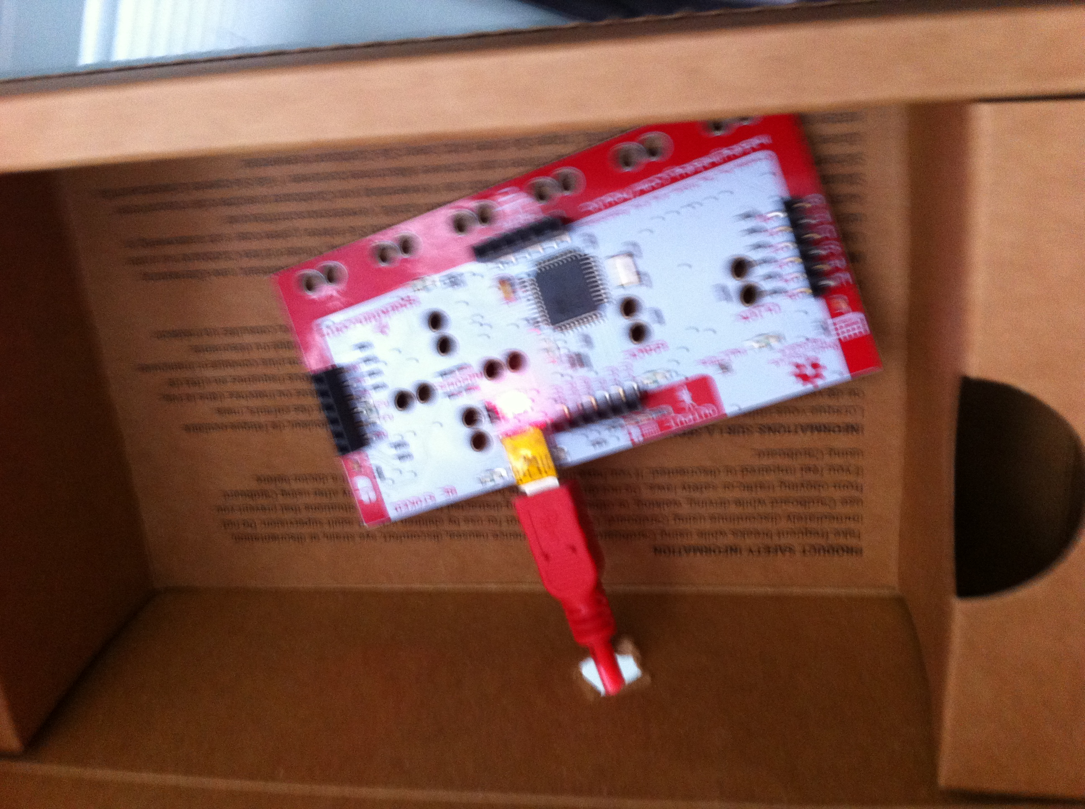
Plug in the Makey Makey

Slide 5
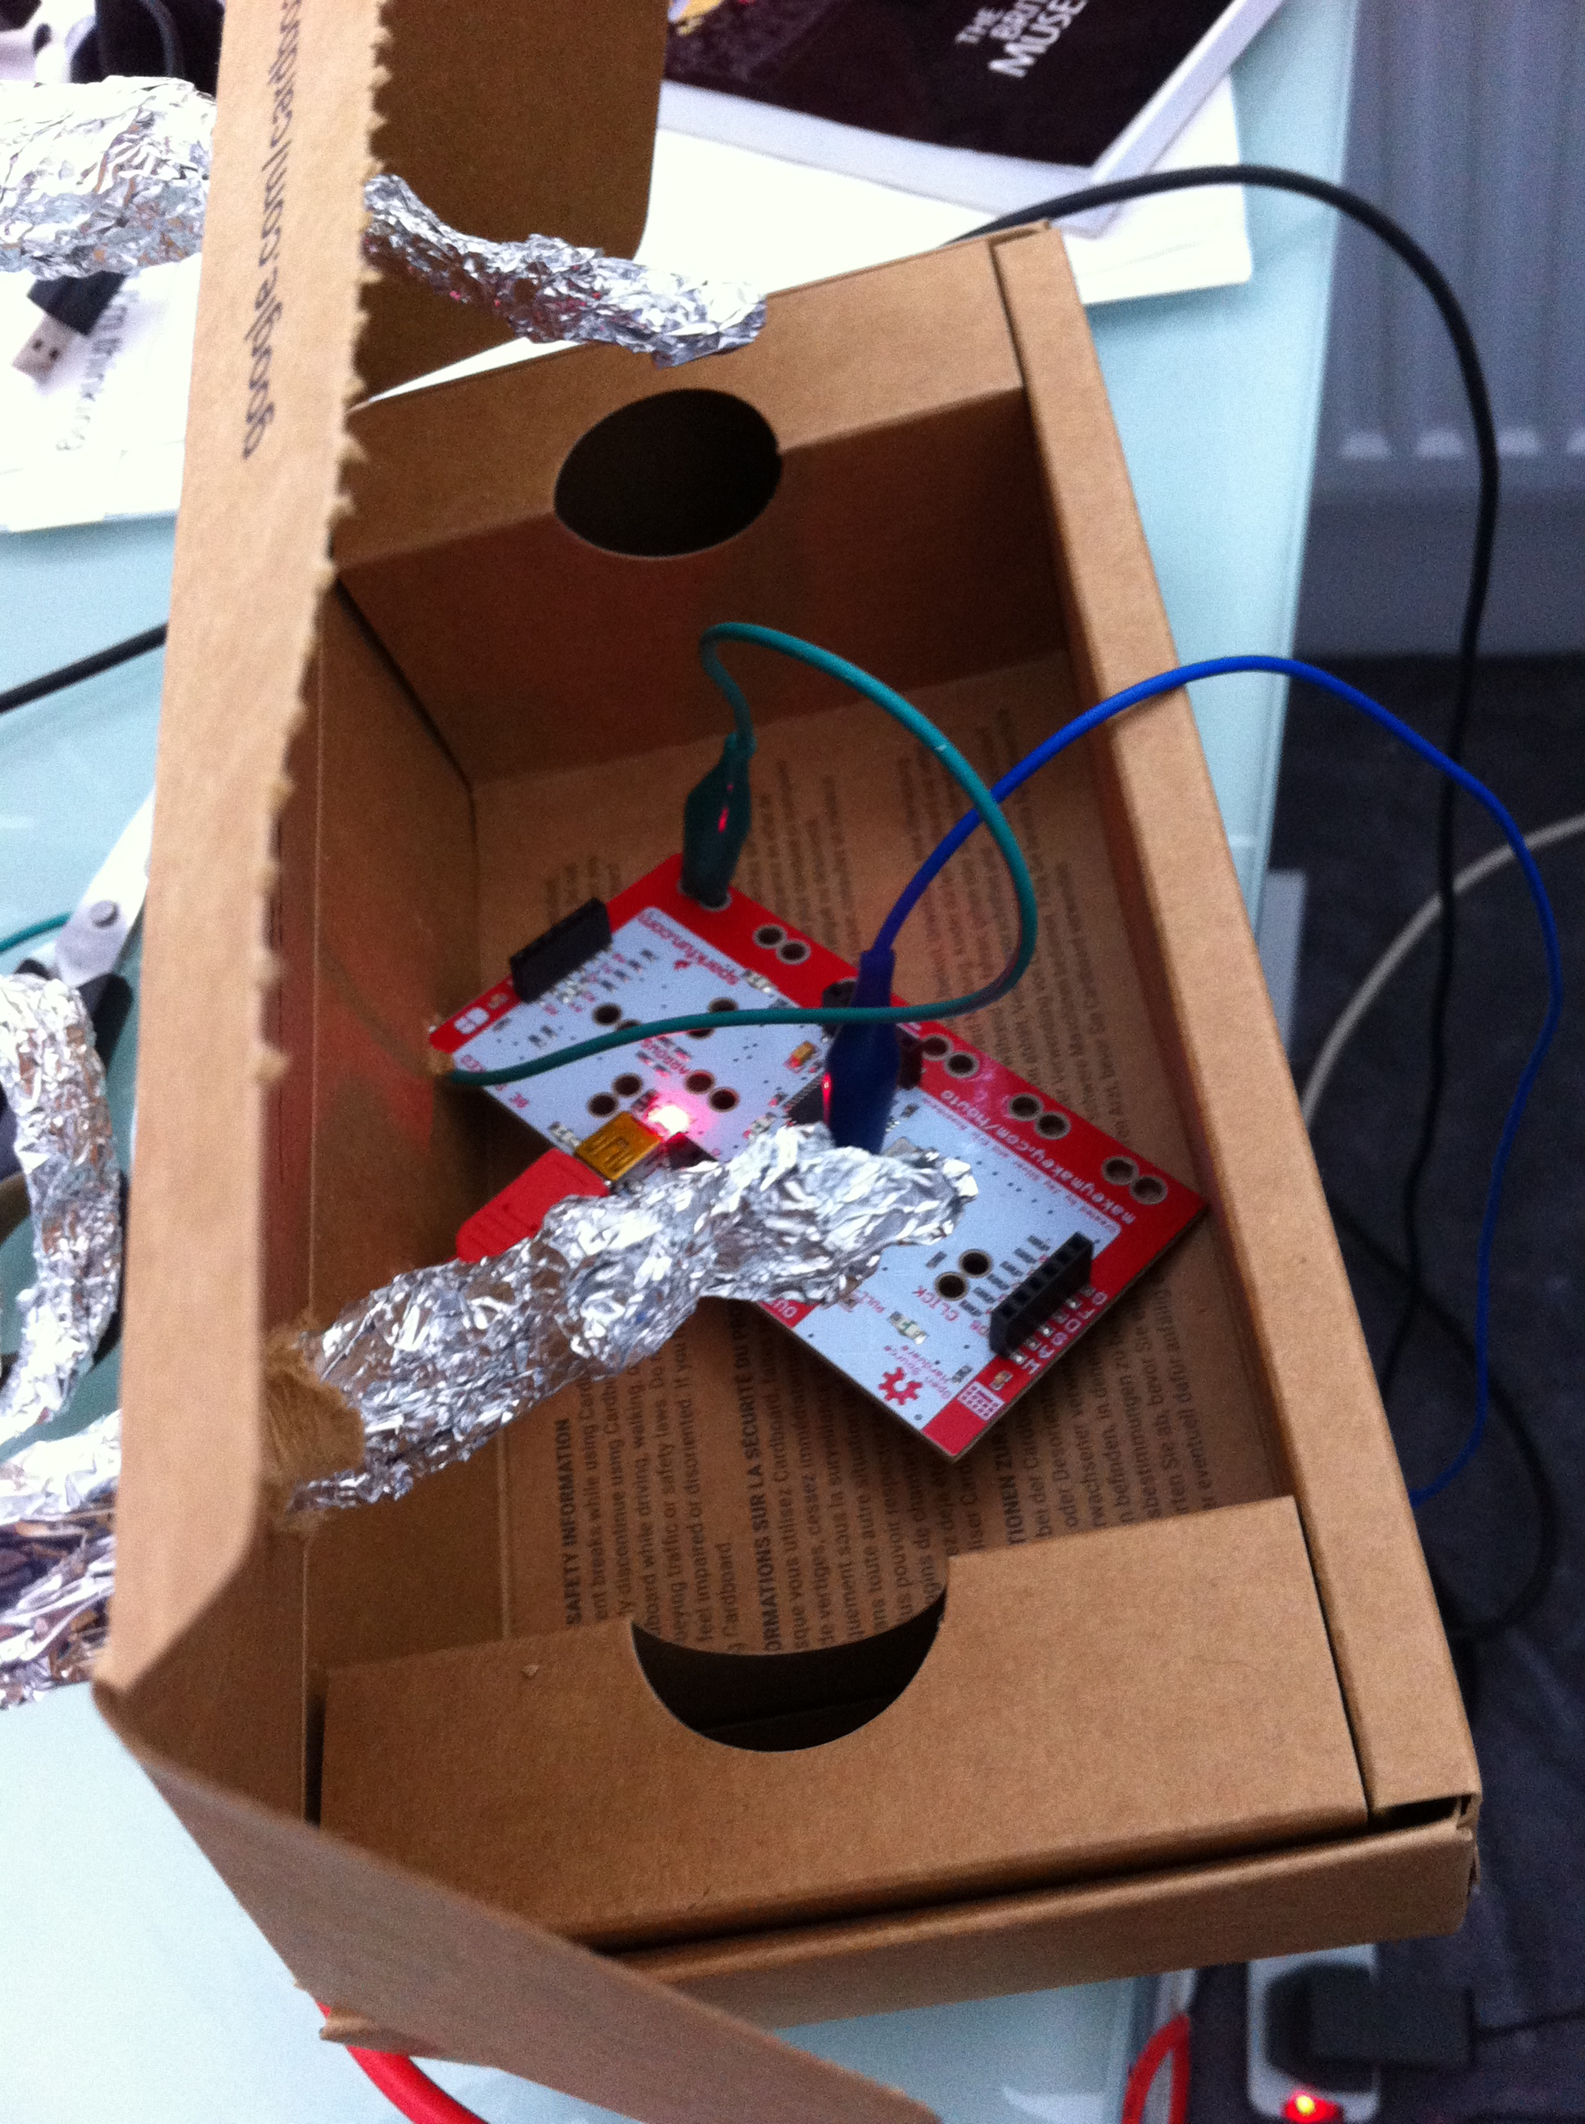
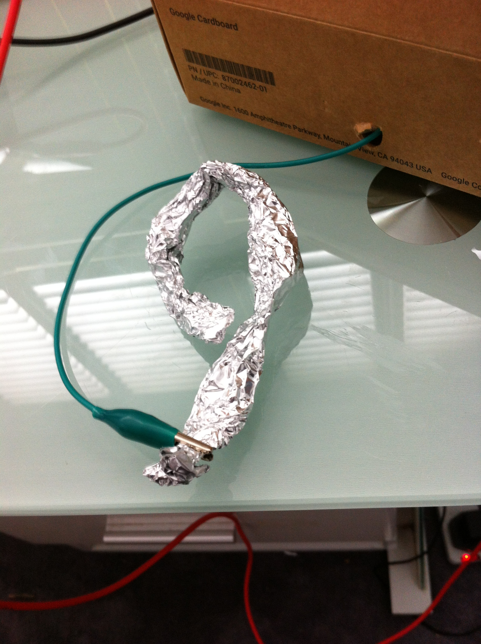
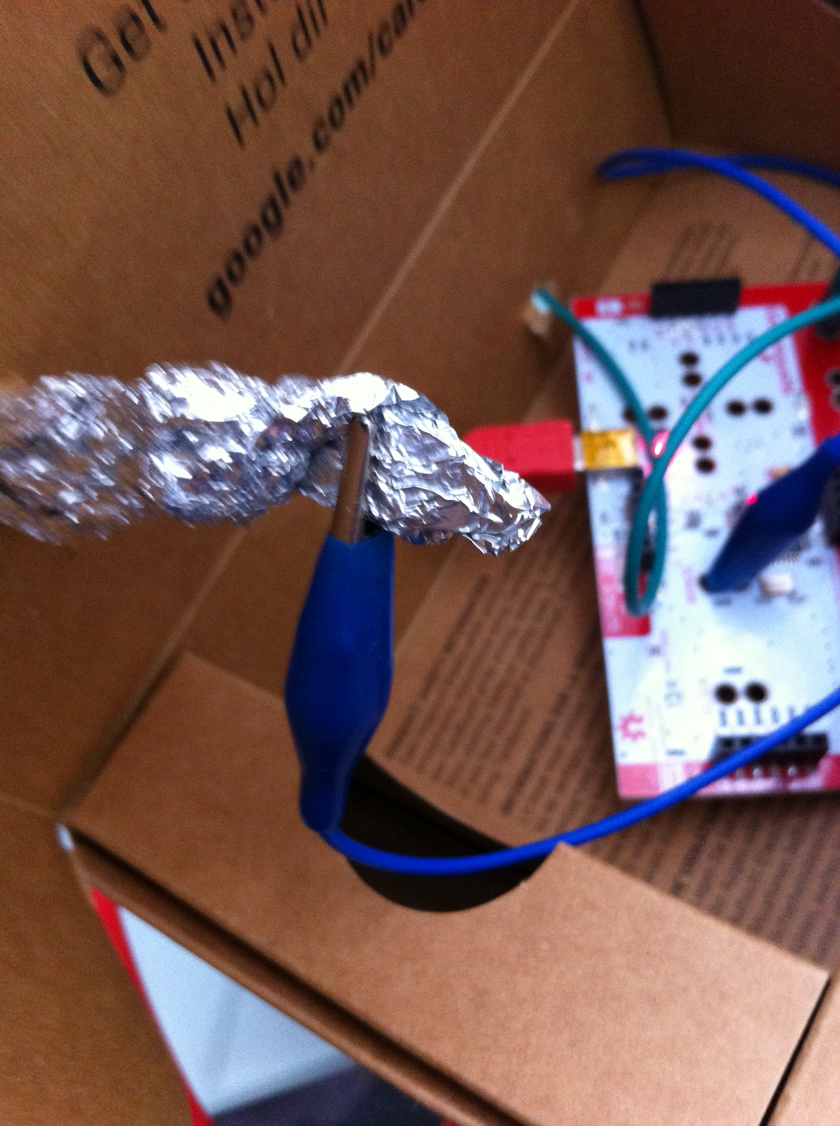
Connect the Cables

Slide 6
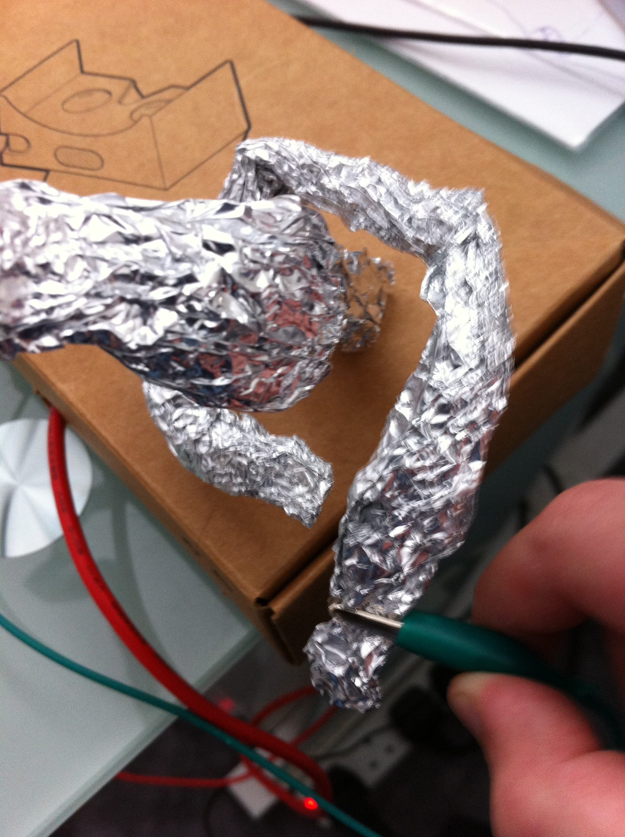
Put in the long Strip of Tinfoil

Slide 7

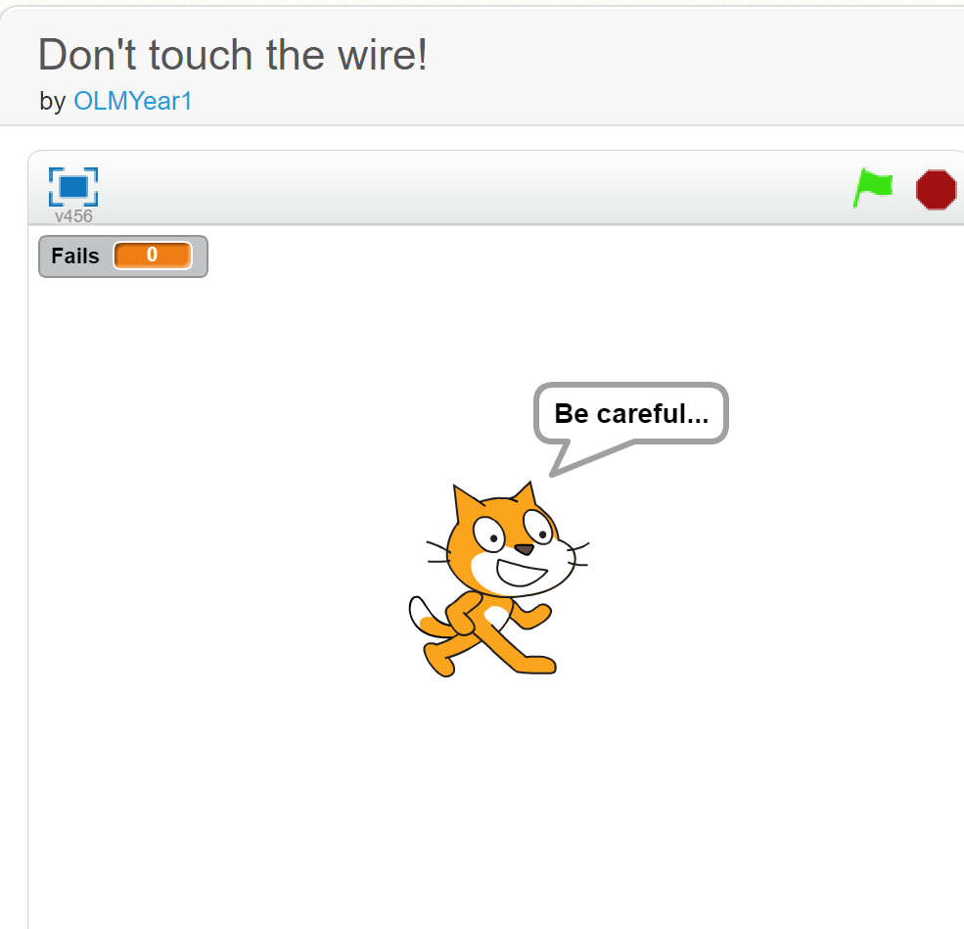
Use the Scratch Project
scratch.mit.edu
https://scratch.mit.edu/projects/167668645/

